Slide 1

Chest Injuries
CHAPTER 30

Slide 2
National EMS Education Standard Competencies (1 of 5)
Trauma
Applies fundamental knowledge to provide basic emergency care and transportation based on assessment findings for an acutely injured patient.
Notes:
National EMS Education Standard Competencies
Trauma
Applies fundamental knowledge to provide basic emergency care and transportation based on assessment findings for an acutely injured patient.

Slide 3
National EMS Education Standard Competencies (2 of 5)
Chest Trauma
Recognition and management of
  Blunt versus penetrating mechanisms
  Open chest wound
  Impaled object
Notes:
National EMS Education Standard Competencies
Chest Trauma
Recognition and management of
• Blunt versus penetrating mechanisms
• Open chest wound
• Impaled object

Slide 4
National EMS Education Standard Competencies (3 of 5)
Chest Trauma (cont’d)
Pathophysiology, assessment, and management of
  Blunt versus penetrating mechanisms
  Hemothorax
Notes:
National EMS Education Standard Competencies
Pathophysiology, assessment, and management of
• Blunt versus penetrating mechanisms
• Hemothorax

Slide 5
National EMS Education Standard Competencies (4 of 5)
Chest Trauma (cont’d)
Pathophysiology, assessment, and management of:
  Pneumothorax
    Open
    Simple
    Tension
Notes:
National EMS Education Standard Competencies
Pneumothorax
Open
Simple
Tension

Slide 6
National EMS Education Standard Competencies (5 of 5)
Chest Trauma (cont’d)
Pathophysiology, assessment, and management of
  Cardiac tamponade
  Rib fractures
  Flail chest
  Commotio cordis
Notes:
National EMS Education Standard Competencies
• Cardiac tamponade
• Rib fractures
• Flail chest
• Commotio cordis

Slide 7
Introduction (1 of 2)
Chest trauma causes more than 1.2 million emergency department visits each year.
Chest injuries can involve the heart, lungs, and great blood vessels.
May be the result of blunt trauma, penetrating trauma, or both
Notes:
Lecture Outline
I. Introduction
A. Chest trauma causes more than 1.2 million emergency department visits each year.
1. Injuries can involve the heart, lungs, and great blood vessels.
2. May be the result of blunt trauma, penetrating trauma, or both

Slide 8
Introduction (2 of 2)
Immediately treat injuries that interfere with normal breathing function.
  Internal bleeding can compress the lungs and heart.
  Air may collect in the chest, preventing lung expansion.
Notes:
Lecture Outline
B. EMTs must treat any injuries that interfere with the body’s mechanics of normal breathing without delay.
1. Internal bleeding can collect in the chest cavity, compressing the lungs or heart.
2. Air may collect in the chest and prevent the lungs from expanding.

Slide 9
Anatomy and Physiology (1 of 5)
Ventilation: the body’s ability to move air in and out of the chest and lung tissue
Oxygenation: the process of delivering oxygen to the blood by diffusion from the alveoli following inhalation into the lungs
Injuries may affect ventilation and/or oxygenation.
Notes:
Lecture Outline
II. Anatomy and Physiology
A. Remember the difference between ventilation and oxygenation.
1. Ventilation is the body’s ability to move air in and out of chest and lung tissue.
2. Oxygenation is the process of delivering oxygen to the blood by diffusion from the alveoli following inhalation into the lungs.
3. Injuries affecting the patient’s ventilation or oxygenation are serious and may be life threatening.
B. The chest (thoracic cage) extends from the lower end of the neck to the diaphragm.
1. A penetrating injury to the chest may also penetrate the lung and diaphragm and injure the liver, spleen, or stomach.

Slide 10
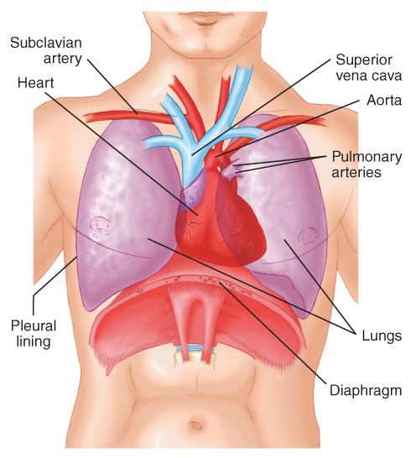
Anatomy and Physiology (2 of 5)
Thoracic skin, muscle, and bones
  Similarities to other regions
  Also unique features to allow for ventilation, such as striated muscle
FIGURE 30-1 A view of the anterior aspect of the chest
shows the major organs beneath the surface.
© Jones & Bartlett Learning.
Notes:
Lecture Outline
C. Thoracic skin, muscle, and bones have similarities to skin, muscle, and bones in other regions of the body.
1. Unique features, such as striated (or skeletal) muscle, allow for ventilation.
a. Intercostal muscles extend between the ribs.
i. Not yet developed in very young children, who tend to breathe from the diaphragm (“belly breathing”)
ii. Innervated from the spinal nerves
iii. Allow the chest to expand on contraction and the active portion of ventilation to occur

Slide 11
Anatomy and Physiology (3 of 5)
The neurovascular bundle lies closely along the lowest margin of each rib.
The pleura covers each lung and the thoracic cavity.
  A small amount of pleural fluid between the parietal and visceral pleura allows the lungs to move freely against the inner chest wall during respiration.
Notes:
Lecture Outline
2. The neurovascular bundle is a network of nerves, arteries, and veins lying closely along the inferior of and slightly posterior to the lowest margin of each rib.
a. Can be a source of significant bleeding into the pleural space
D. The pleura covers each of the lungs and the thoracic cavity.
1. The parietal pleura is the inner chest wall lining.
2. The visceral pleura covers the lung.
3. A small amount of pleural fluid between the parietal and visceral pleura allows the lungs to move freely against the inner chest wall as a person breathes.

Slide 12
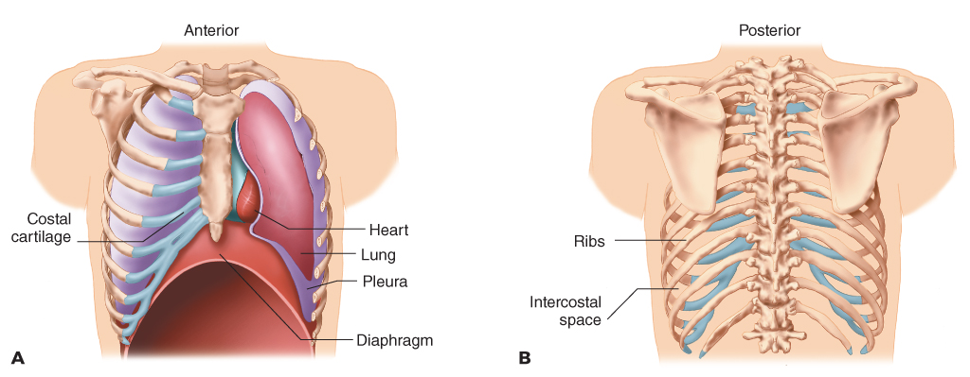
Anatomy and Physiology (4 of 5)
Vital organs, such as the heart, are protected by the ribs.
  Connected in the back to the vertebrae
  Connected in the front to the sternum
FIGURE 30-2 The organs within the chest are protected by the ribs, which are connected in front (A) to the sternum and in back (B) to the vertebrae.
A, B: © Jones & Bartlett Learning.
Notes:
Lecture Outline
E. The ribs are connected, in the back, to the vertebrae and, in the front, to the sternum.
1. The trachea divides into the left and right main stem bronchi, which supply air to the lungs.
2. The thoracic cage contains the heart and the great vessels: the aorta, the right and left subclavian arteries and their branches, the pulmonary arteries, and the superior and inferior venae cavae.

Slide 13
Anatomy and Physiology (5 of 5)
The mediastinum contains the heart, great vessels, esophagus, and trachea.
The diaphragm is a muscle that separates the thoracic cavity from the abdominal cavity.
Notes:
Lecture Outline
3. The mediastinum is the central part of the chest containing the heart, great vessels, esophagus, and trachea.
4. The diaphragm is a muscle that separates the thoracic cavity from the abdominal cavity.

Slide 14
Mechanics of Ventilation (1 of 4)
The intercostal muscles and diaphragm contract during inhalation.
The intercostal muscles and the diaphragm relax during exhalation.
The body should not have to work to breathe when in a resting state.
Notes:
Lecture Outline
III. Mechanics of Ventilation
A. The intercostal muscles (between the ribs) contract during inhalation.
1. The diaphragm contracts or flattens at the same time.
2. The intrathoracic pressure inside the chest decreases, creating a negative pressure differential, allowing air to enter the lungs.
B. The intercostal muscles and diaphragm relax during exhalation, allowing air to be exhaled.

Slide 15
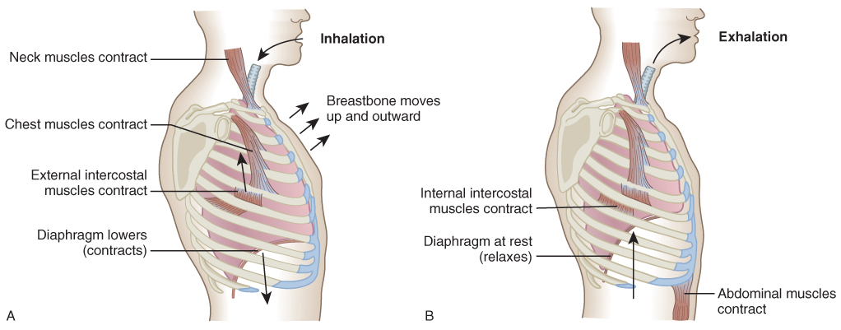
Mechanics of Ventilation (2 of 4)
FIGURE 30-3 The mechanics of inhalation (A) and exhalation (B).
A, B: © Jones & Bartlett Learning.
Notes:
The illustrations on this slide shows the anatomy of the thoracic cavity during inspiration and expiration.

Slide 16
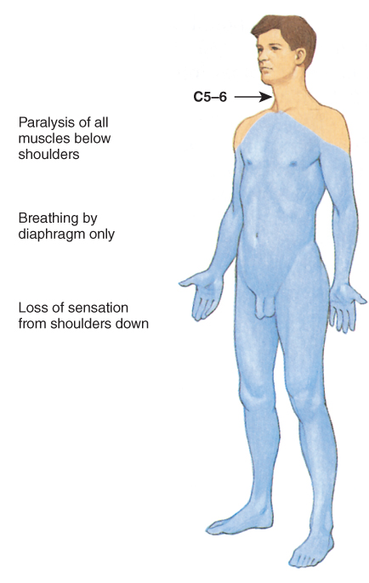
Mechanics of Ventilation (3 of 4)
Patients with a spinal injury below C5 can still breathe from the diaphragm.
Patients with a spinal injury above C3 may lose the ability to breathe.
FIGURE 30-4 A patient who sustains a spinal cord injury below the level of C5 and is paralyzed can still breathe spontaneously because the phrenic nerves, which cause the diaphragm to contract, originate at the C3, C4, and C5 levels.
© Jones & Bartlett Learning.
Notes:
Lecture Outline
C. A patient whose spinal cord is injured below the C5 level may lose the power to move the intercostal muscles.
1. The diaphragm should still contract.
2. The patient will still be able to breathe because the phrenic nerves remain intact.
3. Patients with a spinal injury at C3 or above can lose the ability to breathe entirely.

Slide 17
Mechanics of Ventilation (4 of 4)
Tidal volume is the amount of air moved into or out of the lungs in a single breath.
Minute ventilation is calculated by multiplying the tidal volume by the number of breaths per minute.
Changing either number affects the amount of air moving through the system.
Notes:
Lecture Outline
D. Tidal volume is the amount of air moved into or out of the lungs in a single breath.
1. The average tidal volume is approximately 500 mL.
2. Minute ventilation is calculated by multiplying the tidal volume by the number of breaths in a minute.
3. Changing either of these numbers affects the amount of air moving through the system.
4. The average bag-mask device can deliver 1,000 to 1,500 mL of air.
a. Overventilation can cause gastric distention and impair lung function.
b. Overventilation can also increase intrathoracic pressure, reducing venous return to the heart and thereby reducing cardiac output.

Slide 18
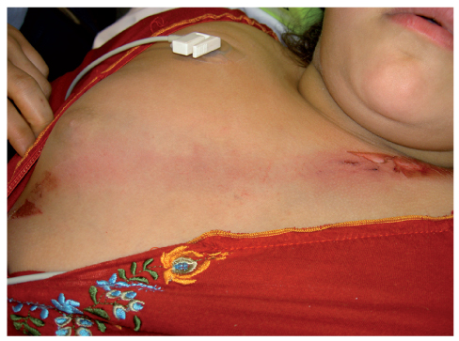
Injuries of the Chest (1 of 7)
Two types: open and closed
In a closed chest injury, the skin is not broken.
  Generally caused by blunt trauma
FIGURE 30-5 Closed chest injuries usually result from blunt trauma, such as when a patient strikes the steering wheel or an airbag in a motor vehicle crash, or is struck by a falling object. A closed chest injury can occur even when a seat belt is worn.
Courtesy of ED, Royal North Shore Hospital/NSW Institute of Trauma & Injury.
Notes:
Lecture Outline
IV. Injuries of the Chest
A. There are two basic types of chest injuries: open and closed.
B. In closed chest injuries, the skin is not broken.
1. They are generally caused by blunt trauma.

Slide 19
Injuries of the Chest (2 of 7)
Closed chest injury
  Can cause significant cardiac and pulmonary contusion
  If the heart is damaged, it may not be able to refill with blood or blood may not be pumped with enough force out of the heart.
  Lung tissue bruising can result in exponential loss of surface area.
  Rib fractures may cause further damage.
Notes:
Lecture Outline
2. They often cause significant contusions in cardiac muscle (cardiac contusion) and lung tissue (pulmonary contusion).
3. If the heart is damaged, it may not be able to refill with blood or blood may not be pumped with enough force out of the heart.
a. Results in cardiogenic shock
4. Lung tissue bruising can result in exponential loss of surface area.
a. Leads to decreased oxygen and carbon dioxide exchange
b. Can cause hypoxic and hypercarbic states
5. Rib fractures can lacerate lung tissues and cause further vessel damage with every chest wall movement.
a. Can rapidly lead to hypovolemic shock

Slide 20
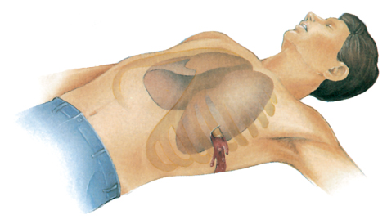
Injuries of the Chest (3 of 7)
In an open chest injury, an object penetrates the chest wall itself.
  Knife, bullet, piece of metal, or broken end of fractured rib
  Do not attempt to move or remove the object.
FIGURE 30-6 Open chest injuries can occur when
an external object or the broken end of a fractured rib penetrates the chest wall.
© Jones & Bartlett Learning.
Notes:
Lecture Outline
C. In open chest injuries, an object penetrates the chest wall itself.
1. Causes instant damage, but symptoms develop over time.
2. An impaled object remains in place.
a. Do not attempt to move or remove the object.
i. May be occluding the hole in the punctured vessel; removal would cause heavy bleeding
ii. May cause damage during removal

Slide 21
Injuries of the Chest (4 of 7)
Blunt trauma to the chest may cause:
  Rib, sternum, and chest wall fractures
  Bruising of the lungs and heart
  Damage to the aorta
  Vital organs to be torn from their attachment in the chest cavity
Notes:
Lecture Outline
D. Blunt trauma to the chest may fracture the ribs, sternum, and chest wall; bruise the lungs and heart; and even damage the aorta.
1. Almost one third of people killed immediately in car crashes die as a result of traumatic rupture of the aorta.

Slide 22
Injuries of the Chest (5 of 7)
Signs and symptoms
  Pain at the site of injury
  Localized pain aggravated or increased with breathing
  Bruising to the chest wall
  Crepitus with palpation of the chest
  Penetrating injury to the chest
  Dyspnea
Notes:
Lecture Outline
E. Signs and symptoms of chest injury
1. Pain at the site of injury
2. Pain localized at the site of injury that is aggravated by or increased with breathing
3. Bruising to the chest wall
4. Crepitus with palpation of the chest
5. Any penetrating injury to the chest
6. Dyspnea

Slide 23
Injuries of the Chest (6 of 7)
Signs and symptoms (cont’d)
  Hemoptysis
  Failure of one or both sides of the chest to expand normally with inspiration
  Rapid, weak pulse and low blood pressure
  Cyanosis around the lips or fingernails
  Diminished breath sounds on one side
  Low oxygen saturation
Notes:
Lecture Outline
7. Hemoptysis
8. Failure of one or both sides of the chest to expand normally with inspiration
Rapid, weak pulse and low blood pressure
10. Cyanosis around the lips or fingernails
Diminished breath sounds on one side
Low oxygen saturation

Slide 24
Injuries of the Chest (7 of 7)
Chest injury patients often have rapid and shallow respirations.
  Hurts to take a deep breath
  Patient may not be moving air.
  Auscultate multiple locations to assess for adequate breath sounds.
Notes:
Lecture Outline
F. Patients with chest injuries often have tachypnea (rapid respirations) and shallow respirations because it hurts to take a deep breath.

Slide 25
Scene Size-up (1 of 2)
Scene safety and standard precautions
  Ensure the scene is safe for you, your partner, your patient, and bystanders.
  If the area is a crime scene, do not disturb evidence if possible.
  Request law enforcement for scenes involving violence.
  Call for ALS early.
Notes:
Lecture Outline
V. Patient Assessment
A. Scene size-up
1. Scene safety and standard precautions
a. If the area is a crime scene, do not disturb evidence if possible.
b. Request the assistance of law enforcement for scenes involving violence.
c. If needed, call for electrical utility, fire department, or ALS units early.
2. Mechanism of injury
a. Chest injuries are common in motor vehicle crashes, falls, industrial accidents, and assaults.
b. Determine the number of patients and consider spinal stabilization.

Slide 26
Scene Size-up (2 of 2)
Mechanism of injury
  Chest injuries are common in motor vehicle crashes, falls, industrial accidents, and assaults.
  Determine the number of patients.
  Consider spinal immobilization.
Notes:
Lecture Outline
2. Mechanism of injury
a. Chest injuries are common in motor vehicle crashes, falls, industrial accidents, and assaults.
b. Determine the number of patients and consider spinal stabilization.

Slide 27
Primary Assessment (1 of 7)
Form a general impression.
  Address life-threatening hemorrhage immediately.
  Note the patient’s level of consciousness.
  Perform a rapid physical examination.
Notes:
Lecture Outline
B. Primary assessment
1. Form a general impression.
a. Life-threatening hemorrhage, when present, should be addressed immediately, even before airway concerns.
b. Note the patient’s level of consciousness.
c. Perform a rapid physical examination.

Slide 28
Primary Assessment (2 of 7)
Airway and breathing
  Ensure that the patient has a clear and patent airway.
  Consider early cervical spine stabilization if appropriate.
  Are jugular veins distended?
  Is breathing present and adequate?
  Inspect for DCAP-BTLS.
Notes:
Lecture Outline
2. Airway and breathing
a. Ensure that the patient has a clear and patent airway.
b. Consider early cervical spinal stabilization when blunt trauma is present.
c. Note whether the jugular veins are distended.
i. Sign of pressure (tamponade) on the heart
d. Determine whether breathing is present and adequate.
e. Inspect for DCAP-BTLS.

Slide 29
Primary Assessment (3 of 7)
Airway and breathing (cont’d)
  Look for equal expansion of the chest wall.
  Check for paradoxical motion.
  Apply occlusive dressings to all penetrating injuries.
  Support ventilations.
Notes:
Lecture Outline
f. Look for equal expansion of the chest wall.
g. Check for paradoxical motion, an abnormality associated with multiple fractured ribs.
h. Apply occlusive dressings to all penetrating injuries to the chest.
i. Apply oxygen with a nonrebreathing mask at 15 L/min.
j. Provide positive pressure ventilation with 100% if breathing is inadequate.

Slide 30
Primary Assessment (4 of 7)
Airway and breathing (cont’d)
  Reassess the effectiveness of ventilatory support.
  Be alert for decreasing oxygen saturation.
  Be alert for impending tension pneumothorax.
Notes:
Lecture Outline
k. Be alert for decreasing oxygen saturation.
l. Be alert for signs of impending tension pneumothorax

Slide 31
Primary Assessment (5 of 7)
Circulation
  Pulse rate and quality
  Skin color and temperature
  Address life-threatening bleeding immediately, using direct pressure and a bulky dressing.
Notes:
Lecture Outline
3. Circulation
a. Assess the pulse and determine whether it is present and adequate. If the pulse is too fast or too slow, or if the skin is pale, cool, or clammy, consider the patient to be in shock.
b. Address life-threatening external bleeding immediately.

Slide 32
Primary Assessment (6 of 7)
Transport decision
  Priority patients are those with a problem with their XABCs.
  Pay attention to subtle clues:
    Appearance of the skin
    Level of consciousness
    A sense of impending doom in the patient
Notes:
Lecture Outline
4. Transport decision
a. Priority patients are those who have a problem with their airway, breathing, or circulation.
b. Pay attention to subtle clues:
i. Appearance of the skin
ii. Level of consciousness
iii. A sense of impending doom in the patient
c. When in doubt, transport the patient rapidly to a hospital
d. Table 30-1 lists the “deadly dozen” chest injuries.

Slide 33
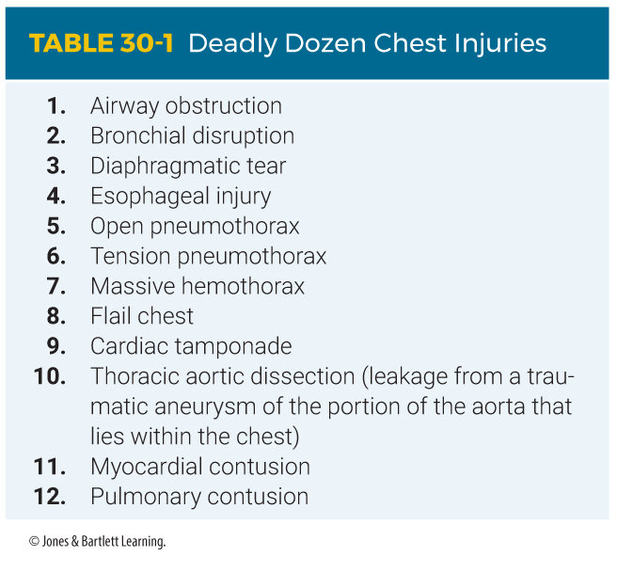
Primary Assessment (7 of 7)
Notes:
The table on this slide lists the deadly dozen chest injuries.

Slide 34
History Taking
Investigate the chief complaint.
  Further investigate the MOI.
  Identify signs, symptoms, and pertinent negatives.
SAMPLE history
  A basic evaluation should be completed.
  Focus on the MOI.
Notes:
Lecture Outline
C. History taking
1. Investigate the chief complaint.
a. Further investigate the mechanism of injury (MOI).
b. Identify associated signs and symptoms and pertinent negatives.
2. Questions should focus on the MOI:
a. Speed of the vehicle or height of the fall
b. Use of safety equipment
c. Type of weapon used
d. Number of penetrating wounds
3. SAMPLE history
a. Complete a basic evaluation if time allows.

Slide 35
Secondary Assessment (1 of 3)
Physical examinations
  For an isolated injury, focus on:
    Isolated injury
    Patient’s complaint
    Body region affected
    Location and extent of injury
    Anterior and posterior aspects of the chest wall
    Changes in respirations
Notes:
Lecture Outline
D. Secondary assessment
1. Physical examinations
a. For an isolated injury with a limited MOI, focus on:
i. Isolated injury
ii. Patient’s complaint
iii. Body region affected
iv. Ensuring wounds are identified and bleeding controlled
v. Location and extent of injury
vi. Assessment of all underlying systems
vii. Anterior and posterior aspects of the chest wall
viii. Changes in the patient’s ability to maintain adequate respirations

Slide 36
Secondary Assessment (2 of 3)
Physical examinations (cont’d)
  For significant trauma likely affecting multiple systems, start with a rapid physical examination.
  Use DCAP-BTLS to determine the nature and extent of the injury.
Notes:
Lecture Outline
b. For significant trauma likely affecting multiple systems, start with a rapid physical examination
i. Use DCAP-BTLS to determine the nature and extent of the thoracic injury.

Slide 37
Secondary Assessment (3 of 3)
Vital signs
  Assess pulse, respirations, blood pressure, skin condition, oxygen saturation, and pupils.
  Reevaluate every 5 minutes or less.
  Pulse and respiratory rates may decrease in later stages of the chest injury.
Notes:
Lecture Outline
2. Vital signs
a. Assess pulse, respirations, blood pressure, skin condition, oxygen saturation, and pupils.
b. Reevaluate the patient every 5 minutes or less.
c. A rapid pulse or respiratory rate may indicate that the chest injury is causing a decrease in available oxygen (hypoxia) or blood loss resulting in decreased red blood cell count (hypoxemia).
d. Increased work of breathing can be identified by the use of accessory muscles in the face, neck, and chest.
e. Pulse and respiratory rates may decrease in later stages of chest injury.

Slide 38
Reassessment (1 of 3)
Repeat the primary assessment.
Reassess the chief complaint.
Reevaluate:
  Airway
  Breathing
  Pulse
  Perfusion
  Bleeding
Notes:
Lecture Outline
E. Reassessment
1. Repeat the primary assessment.
2. Reassess the chief complaint.
3. Reevaluate:
a. Airway
b. Breathing
c. Pulse
d. Perfusion
e. Bleeding

Slide 39
Reassessment (2 of 3)
Interventions
  Reassess vital signs and observe trends.
  Provide appropriate spinal stabilization when indicated.
  Maintain an open airway.
  Control significant, visible bleeding.
  Place an occlusive dressing over penetrating trauma to the chest wall.
Notes:
Lecture Outline
Interventions
a. Reassess vital signs and observe trends.
b. Provide appropriate spinal stabilization for patients who have blunt trauma with suspected spinal injuries.
c. Maintain an open airway.
d. Control significant, visible bleeding
e. Place a vented chest seal or semivented dressing over penetrating trauma to the chest wall.

Slide 40
Reassessment (3 of 3)
Interventions (cont’d)
  Provide aggressive treatment for shock and rapid transport.
  Do not delay transport to complete non–life-saving treatments.
Communicate all relevant information to the staff at the receiving hospital.
Notes:
Lecture Outline
f. Provide aggressive treatment for shock and transport rapidly.
g. Do not delay transport to complete non–life-saving treatments; these can be performed en route to the hospital.
5. Communication and documentation
a. Communicate all relevant information to the staff at the receiving hospital.

Slide 41
Pneumothorax (1 of 7)
Commonly called a collapsed lung
Accumulation of air in the pleural space
  Blood passing through the collapsed portion of the lung is not oxygenated.
  You may hear diminished, absent, or abnormal breath sounds.
Notes:
Lecture Outline
VI. Complications and Management of Chest Injuries
A. Pneumothorax
1. Defined as an accumulation of air in the pleural space
a. Air enters through a hole in the chest wall or surface of the lung.
b. The patient’s attempts to breathe cause the lung on that side to collapse.
2. Blood passing through the collapsed portion of the lung is not oxygenated.
3. Breath sounds on the affected side of the chest indicate different conditions.
a. If the lung is collapsed past 30% to 40%, you may hear diminished breath sounds.
b. Absent breath sounds may indicate a tension pneumothorax.
c. A sucking sound on inhalation and the sound of rushing air on exhalation indicate that the chest wall has been penetrated.

Slide 42
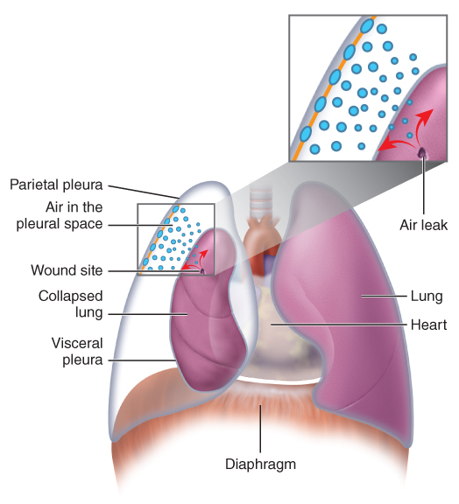
Pneumothorax (2 of 7)
FIGURE 30-8 Pneumothorax occurs when air leaks into
the space between the pleural surfaces from an opening in
the chest wall or the surface of the lung. Air in the pleural
space causes the lung to collapse.
© Jones & Bartlett Learning.
Notes:
The illustration on this slide shows how a pneumothorax occurs. Air leaks into the space between the pleural surfaces from an opening in the chest wall or the surface of the lung. Air in the pleural space causes the lung to collapse.

Slide 43
Pneumothorax (3 of 7)
Open chest wound
  Often called an open pneumothorax or a sucking chest wound
  Wounds must be rapidly sealed with an occlusive dressing.
  A flutter valve is a one-way valve.
  Carefully monitor the patient for tension pneumothorax.
Notes:
Lecture Outline
4. An open chest wound is often called an open pneumothorax or a sucking chest wound.
a. After clearing and maintaining a patient’s airway and then providing oxygen, these wounds must be rapidly sealed with an occlusive dressing.
A flutter valve is a one-way valve that allows air to leave the chest cavity but not return. Follow local protocols and the manufacturer’s guidelines.
6. An occlusive dressing without a flutter valve may be taped to the patient on three sides of the dressing, allowing air to leak from the fourth side.
7. After applying the dressing, carefully monitor the patient for signs of a tension pneumothorax.
a. If it develops, open the occlusive dressing on one side.

Slide 44
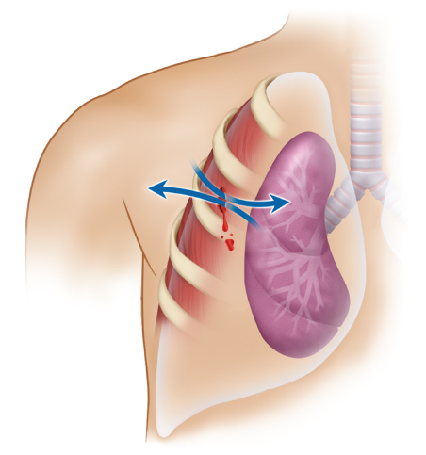
Pneumothorax (4 of 7)
FIGURE 30-9 With a sucking chest wound, air passes
from the outside into the pleural space and back out with
each breath, creating a sucking sound
© Jones & Bartlett Learning.
Notes:
The illustration on this slide shows a sucking chest wound. The air passes from outside into the pleural space and back out with each breath, creating a sucking sound.

Slide 45
Pneumothorax (5 of 7)
Simple pneumothorax
  Does not result in major changes in the patient’s cardiac physiology
  Commonly due to blunt trauma that results in fractured ribs
  Can often worsen, deteriorate into tension pneumothorax, or develop complications
Notes:
Lecture Outline
8. Simple pneumothorax
a. Does not result in major changes in a patient’s cardiac physiology
b. Commonly the result of blunt trauma that results in fractured ribs
c. Signs and symptoms include pleuritic chest pain, dyspnea, tachypnea, accessory muscle use, decreased oxygen saturation, and a crackling sensation felt on palpation of the skin (subcutaneous emphysema).
d. Late findings can be decreased breath sounds on the injured side as well as lethargy and cyanosis.
e. Prehospital treatment:
i. Provide high-flow oxygen.
ii. Monitor oximeter readings and breath sounds.

Slide 46
Pneumothorax (6 of 7)
Tension pneumothorax
  Results from ongoing air accumulation in the pleural space
  Increased pressure in the chest:
    Causes complete collapse of the unaffected lung
    Mediastinum is pushed into the opposite pleural cavity.
  Commonly caused by a blunt injury where a fractured rib lacerates a lung or bronchus
Notes:
Lecture Outline
9. Tension pneumothorax
a. Results from ongoing air accumulation in the pleural space
b. This air gradually increases the pressure in the chest.
i. Causes complete collapse of the unaffected lung
ii. Mediastinum is pushed into the opposite pleural cavity
c. More commonly caused by blunt injury in which a fractured rib lacerates a lung or bronchus.
d. Common signs and symptoms include chest pain, tachycardia, marked respiratory distress, low or rapidly dropping oxygen saturation, and absent or severely decreased lung sounds on the affected side, with signs of shock.
e. The patient may also present with JVD, cyanosis, or tracheal deviation, but these signs are not always present.
f. Prehospital treatment:
i. Support ventilation with high-flow oxygen.
ii. Request ALS support or transport immediately.
iii. Needle decompression may be performed by ALS personnel or emergency department staff depending on local protocols.

Slide 47
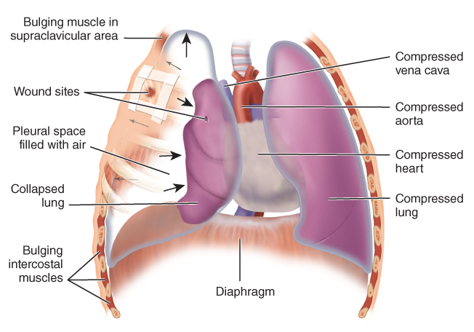
Pneumothorax (7 of 7)
FIGURE 30-12 A tension pneumothorax can develop if a penetrating chest wound is bandaged tightly and air from a damaged lung cannot escape. The air then accumulates in the pleural space, eventually causing compression of the heart and great vessels. If a dressing sealed on four sides with no vent is used, monitor for signs of tension pneumothorax developing and prepare to vent one side of the dressing.
© Jones & Bartlett Learning.
Notes:
The illustration on this slide shows a tension pneumothorax.

Slide 48
Hemothorax (1 of 3)
Blood collects in the pleural space from bleeding around the rib cage or from a lung or great vessel.
Notes:
Lecture Outline
B. Hemothorax
1. A condition in which blood collects in the pleural space from bleeding around the rib cage or from a lung or great vessel

Slide 49
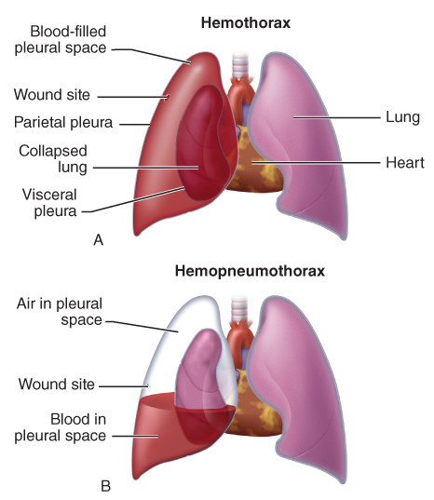
Hemothorax (2 of 3)
FIGURE 30-13 A. A hemothorax is a collection of blood in the pleural space produced by bleeding within the chest. B. When both blood and air are present, the condition is a hemopneumothorax.
A, B: © Jones & Bartlett Learning.
Notes:
The illustrations on this slide shows a hemothorax and hemopneumothorax. A hemothorax is a collection of blood in the pleural space produced by bleeding within the chest. When both blood and air are present, the condition is a hemopneumothorax.

Slide 50
Hemothorax (3 of 3)
Signs and symptoms
  Shock without any obvious external bleeding or apparent reason for shock
  Decreased breath sounds on the affected side
Prehospital treatment
  Rapid transport
Hemopneumothorax: the presence of air and blood in the pleural space
Notes:
Lecture Outline
2. Suspect a hemothorax if the patient has signs and symptoms of shock without any obvious external bleeding, or decreased breath sounds on the affected side.
3. Prehospital treatment:
a. Bleeding cannot be controlled in the prehospital setting.
b. Provide rapid transport to the nearest facility capable of performing surgery.
4. The presence of air and blood in the pleural space is known as a hemopneumothorax

Slide 51
Cardiac Tamponade (1 of 3)
Protective membrane (pericardium) around the heart fills with blood or fluid.
The heart cannot pump an adequate amount of blood.
Notes:
Lecture Outline
C. Cardiac tamponade
1. Cardiac tamponade (pericardial tamponade) occurs when the pericardial sac fills with blood or fluid.
2. The heart then cannot pump an adequate amount of blood.

Slide 52
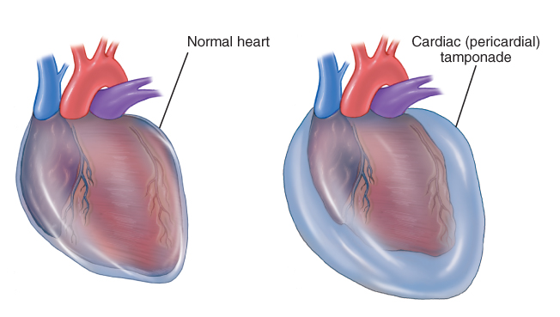
Cardiac Tamponade (2 of 3)
FIGURE 30-14 Cardiac tamponade, also known as pericardial tamponade,
is a potentially fatal condition in which fluid or blood builds up within
the pericardial sac, causing compression of the heart’s chambers and
dramatically impairing its ability to pump blood to the body.
© Jones & Bartlett Learning.
Notes:
This illustration shows cardiac tamponade. With cardiac tamponade, fluid builds up within the pericardial sac, causing compression of the heart’s chambers and dramatically impairing its ability to pump blood to the body.

Slide 53
Cardiac Tamponade (3 of 3)
Signs and symptoms
  Beck triad
  Altered mental status
Prehospital treatment
  Support ventilations
  Rapidly transport
Notes:
Lecture Outline
3. Signs and symptoms are referred to as the Beck triad and include distended or engorged jugular veins on both sides of the trachea, a narrowing pulse pressure, and muffled heart sounds.
4. Prehospital treatment:
a. Support ventilations.
b. Rapidly transport the patient to a facility capable of intervention.

Slide 54
Rib Fractures (1 of 2)
Common, particularly in older people
A fracture of one of the upper four ribs is a sign of a substantial MOI.
A fractured rib may cause a pneumothorax, hemothorax, or hemopneumothorax.
Notes:
Lecture Outline
D. Rib fractures
1. Common, particularly in older people whose bones are brittle
2. A fracture of one of the upper four ribs is a sign of a substantial MOI.
3. A fractured rib may lacerate the surface of the lung, causing a pneumothorax, a tension pneumothorax, a hemothorax, or a hemopneumothorax.

Slide 55
Rib Fractures (2 of 2)
Signs and symptoms
  Localized tenderness and pain when breathing
  Rapid, shallow respirations
  Patient holding the affected portion of the rib cage
Prehospital treatment includes supplemental oxygen.
Notes:
Lecture Outline
4. Patients with one or more cracked ribs will report localized tenderness and pain when breathing.
5. Prehospital treatment:
a. Supplemental oxygen

Slide 56
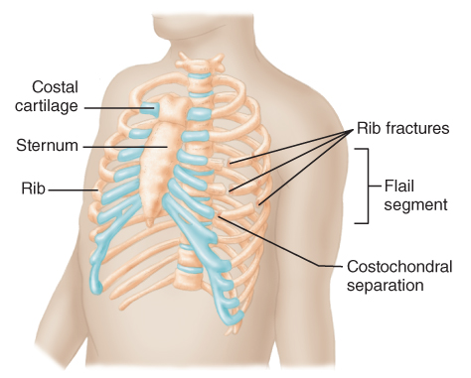
Flail Chest (1 of 3)
Caused by compound rib fractures that detach a segment of the chest wall
Detached portion moves opposite of normal
FIGURE 30-15 When two or more adjacent ribs are fractured in two or more places, a flail chest results. A flail segment will move paradoxically when the patient breathes.
© Jones & Bartlett Learning.
Notes:
Lecture Outline
E. Flail chest
1. Caused by two or more adjacent ribs fractured in two or more places causing a segment of the chest wall to detach from the rest of the thoracic cage.
2. The detached portion of the chest wall moves opposite of normal (paradoxical motion).
a. Paradoxical motion is a late sign of flail segment.

Slide 57
Flail Chest (2 of 3)
Prehospital treatment
  Maintain the airway.
  Provide respiratory support, if needed.
  Give supplemental oxygen.
  Perform ongoing assessments for complications.
Notes:
Lecture Outline
3. Prehospital treatment:
a. Maintain the airway.
b. Provide respiratory support, if needed.
c. Give supplemental oxygen.
d. Perform ongoing assessments for possible pneumothorax or other respiratory complications.

Slide 58
Flail Chest (3 of 3)
Treatment may include positive pressure ventilation with a bag-mask device.
Restricting chest wall movement is no longer recommended.
Flail chest may indicate serious internal damage or spinal injury.
Notes:
Lecture Outline
e. Treatment may also include positive pressure ventilation with a bag-mask device.
f. Restricting chest wall movement (splinting of the flail segment with bulky dressing) is no longer recommended.
4. Flail chest may indicate serious internal damage and possible spinal injury.

Slide 59
Other Chest Injuries (1 of 8)
Pulmonary contusion
  Should always be suspected in a patient with a flail chest
  Pulmonary alveoli become filled with blood, leading to hypoxia.
  Prehospital treatment
    Supplemental oxygen and positive pressure ventilation as needed
Notes:
Lecture Outline
VII. Other Chest Injuries
A. Pulmonary contusion
1. Should always be suspected in a patient with a flail chest
2. The pulmonary alveoli become filled with blood, and fluid accumulates in the injured area, leaving the patient hypoxic.
3. Prehospital treatment:
a. Provide supplemental oxygen and positive pressure ventilation as needed to ensure adequate oxygenation and ventilation.

Slide 60
Other Chest Injuries (2 of 8)
Other fractures
  Sternal fractures
    Create an increased index of suspicion for organ injury
  Clavicle fractures
    Possible damage to neurovascular bundle
    Suspect upper rib fractures in medial clavicle fractures.
    Be alert to pneumothorax development.
Notes:
Lecture Outline
B. Other fractures
1. Sternal fractures
a. Require a significant amount of force
b. May involve the lungs, great vessels, and the heart
2. Clavicle fractures
a. Significant damage or disruption to the large neurovascular bundle the clavicle protects is possible.
b. Suspect upper rib fractures in medial clavicle fractures.
c. Be alert to possible signs of pneumothorax development.

Slide 61
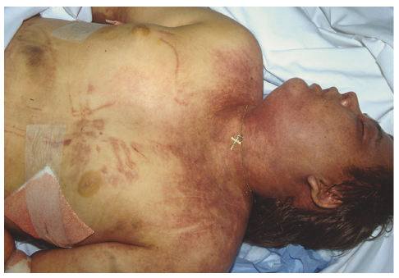
Other Chest Injuries (3 of 8)
Traumatic asphyxia
  Characterized by distended neck veins, cyanosis in the face and neck, and hemorrhage in the sclera of the eye
FIGURE 30-16 Traumatic asphyxia.
© Charles Stewart MD, EMDM MPH.
Notes:
Lecture Outline
Traumatic asphyxia
1. Sudden, severe compression of the chest, which produces a rapid increase in pressure within the chest.
2. Characterized by:
a. Distended neck veins
b. Cyanosis in the face and neck
c. Hemorrhage into the sclera of the eye

Slide 62
Other Chest Injuries (4 of 8)
Traumatic asphyxia (cont’d)
  Suggests an underlying injury to the heart and possibly a pulmonary contusion
  Prehospital treatment
    Ventilatory support and supplemental oxygen
    Monitor vital signs during immediate transport.
Notes:
Lecture Outline
3. Suggests an underlying injury to the heart and possibly a pulmonary contusion
4. Prehospital treatment:
a. Provide ventilatory support with supplemental oxygen.
b. Monitor vital signs during immediate transport.

Slide 63
Other Chest Injuries (5 of 8)
Blunt myocardial injury
  Bruising of the heart muscle
  The heart may be unable to maintain adequate blood pressure.
  Signs and symptoms
    Irregular pulse rate
    Chest pain or discomfort
Notes:
Lecture Outline
D. Blunt myocardial injury
1. Blunt trauma may injure the heart itself, making it unable to maintain adequate blood pressure.
2. Often the pulse is irregular, but dangerous rhythms such as ventricular tachycardia and ventricular fibrillation are uncommon.
3. Suspect myocardial contusion in all cases of severe blunt injury to the chest.
4. Prehospital treatment:
a. Monitor the patient’s pulse carefully.
b. Note any change in blood pressure.
c. Provide supplemental oxygen and transport immediately.

Slide 64
Other Chest Injuries (6 of 8)
Blunt myocardial injury (cont’d)
  Suspect it in all cases of severe blunt injury to the chest.
  Prehospital treatment
    Carefully monitor the pulse.
    Note changes in blood pressure.
    Provide supplemental oxygen and transport immediately.
Notes:
Lecture Outline
3. Suspect myocardial contusion in all cases of severe blunt injury to the chest.
4. Prehospital treatment:
a. Monitor the patient’s pulse carefully.
b. Note any change in blood pressure.
c. Provide supplemental oxygen and transport immediately.

Slide 65
Other Chest Injuries (7 of 8)
Commotio cordis
  Injury caused by a sudden, direct blow to the chest during a critical portion of the heartbeat
  May result in immediate cardiac arrest
  Ventricular fibrillation is often responsive to defibrillation and early initiation of CPR.
Notes:
Lecture Outline
E. Commotio cordis
1. Blunt chest injury caused by a sudden, direct blow to the chest that occurs only during the critical portion of a person’s heartbeat, resulting in immediate cardiac arrest
2. The resulting ventricular fibrillation is often responsive to responsive to defibrillation and early initiation of CPR.
3. More commonly associated with sports-related injuries, but should be suspected in all cases in which the person is unconscious and unresponsive after a blow to the chest

Slide 66
Other Chest Injuries (8 of 8)
Laceration of the great vessels
  May result in rapidly fatal hemorrhage
  Prehospital treatment
    Cardiopulmonary resuscitation
    Ventilatory support and supplemental oxygen, if needed
    Immediate transport
    Be alert for shock.
    Monitor for changes in baseline vital signs.
Notes:
Lecture Outline
F. Laceration of the great vessels
1. May be accompanied by massive, rapidly fatal hemorrhage
2. Prehospital treatment:
a. Cardiopulmonary resuscitation
b. Ventilatory support and supplemental oxygen, if appropriate
c. Immediate transport
d. Remain alert to signs and symptoms of shock.
e. Closely monitor changes in baseline vital signs (eg, tachycardia and hypotension).

Slide 67
Review
When the chest impacts the steering wheel during a motor vehicle crash with rapid deceleration, the resulting injury that kills almost one-third of patients, usually within seconds, is:
  a hemothorax.
  aortic shearing.
  a pneumothorax.
  a ruptured myocardium.

Slide 68
Review
Answer: B
Rationale: When the chest impacts the steering wheel following rapid forward deceleration, aortic injuries (shearing or rupture) are the cause of death in nearly one-thirds of patients. The aorta is the largest artery in the body; when it is sheared from its supporting structures or ruptures outright, exsanguination (bleeding to death) occurs—usually within a matter of seconds.

Slide 69
Review
When the chest impacts the steering wheel during a motor vehicle crash with rapid deceleration, the resulting injury that kills almost one third of patients, usually within seconds, is:
  a hemothorax.
  Rationale: This is a serious injury but is not fatal in seconds.
  aortic shearing.
  Rationale: Correct answer
  a pneumothorax.
  Rationale: This is a serious injury but is not fatal in seconds.
  a ruptured myocardium.
  Rationale: This is a serious injury but is not common.

Slide 70
Review
Signs and symptoms of a chest injury include all of the following, EXCEPT:
  hemoptysis.
  hematemesis.
  asymmetric chest movement.
  increased pain with breathing.

Slide 71
Review
Answer: B
Rationale: Signs and symptoms of a chest injury include bruising to the chest, chest wall instability, increased pain with breathing, asymmetric (unequal) chest movement if a pneumothorax is present, and hemoptysis (coughing up blood) if intrapulmonary bleeding is occurring. Hematemesis (vomiting blood) indicates bleeding in the gastrointestinal tract—usually the esophagus or stomach—not the chest cavity.

Slide 72
Review
Signs and symptoms of a chest injury include all of the following, EXCEPT:
  hemoptysis.
  Rationale: Hemoptysis is coughing up blood or blood-tinged sputum.
  hematemesis.
  Rationale: Correct answer
  asymmetric chest movement.
  Rationale: This may indicate a flail chest or pneumothorax.
  increased pain with breathing.
  Rationale: A chest injury will cause the presence of pain during inspiratory or expiratory chest wall movement.

Slide 73
Review
During your assessment of a patient who was stabbed, you see an open wound to the left anterior chest. Your MOST immediate action should be to:
  position the patient on the affected side.
  transport immediately.
  assess the patient for a tension pneumothorax.
  cover the wound with an occlusive dressing.

Slide 74
Review
Answer: D
Rationale: If you encounter an open chest wound, you must cover it with an occlusive dressing. This will prevent air from moving in and out of the wound. After the dressing is applied, you must monitor the patient for signs of a developing tension pneumothorax.

Slide 75
Review
During your assessment of a patient who was stabbed, you see an open wound to the left anterior chest. Your MOST immediate action should be to:
  position the patient on the affected side.
  Rationale: This is not the most immediate action.
  transport immediately.
  Rationale: Transport should take place once life threats have been managed.
  assess the patient for a tension pneumothorax.
  Rationale: You must monitor for signs of a developing pneumothorax.
  cover the wound with an occlusive dressing.
  Rationale: Correct answer

Slide 76
Review
When caring for a patient with signs of a pneumothorax, your MOST immediate concern should be:
  hypovolemia.
  intrathoracic bleeding.
  ventilatory inadequacy.
  associated myocardial injury.

Slide 77
Review
Answer: C
Rationale: A pneumothorax occurs when air enters the pleural space and progressively collapses the lung. This impairs the ability of the lung to move air in and out (ventilate). As the lung collapses further, ventilatory efficiency decreases, resulting in hypoxemia; this should be your most immediate concern. Some patients with a pneumothorax may also experience intrathoracic bleeding and associated myocardial injury, depending on the mechanism of injury and the force of the trauma.

Slide 78
Review
When caring for a patient with signs of a pneumothorax, your MOST immediate concern should be:
  hypovolemia.
  Rationale: This may be indicated by the signs and symptoms of shock.
  intrathoracic bleeding.
  Rationale: The patient may experience this, but inadequate ventilation is your immediate concern.
  ventilatory inadequacy.
  Rationale: Correct answer
  associated myocardial injury.
  Rationale: The patient may experience this, but inadequate ventilation is your immediate concern.

Slide 79
Review
What purpose does a one-way “flutter valve” serve when used on a patient with an open pneumothorax?
  It prevents air escape from within the chest cavity.
  It allows the release of air trapped in the pleural space.
  It only prevents air from entering an open chest wound.
  It allows air to freely move in and out of the chest cavity.

Slide 80
Review
Answer: B
Rationale: A one-way flutter valve is used to treat patients with an open pneumothorax (sucking chest wound), and serves two purposes: it allows air trapped in the pleural space to escape during exhalation, and it prevents air from entering the pleural space during inhalation. These combined effects alleviate pressure on the affected lung, which allows it to reexpand.

Slide 81
Review
What purpose does a one-way “flutter valve” serve when used on a patient with an open pneumothorax?
  It prevents air escape from within the chest cavity.
  Rationale: It allows air to exit the chest.
  It allows the release of air trapped in the pleural space.
  Rationale: Correct answer
  It only prevents air from entering an open chest wound.
  Rationale: It prevents air from entering and allows air to exit the chest.
  It allows air to freely move in and out of the chest cavity.
  Rationale: It allows air to move out freely and prevents air from entering.

Slide 82
Review
Signs of a cardiac tamponade include all of the following, EXCEPT:
  muffled heart tones.
  a weak, rapid pulse.
  collapsed jugular veins.
  narrowing pulse pressure.

Slide 83
Review
Answer: C
Rationale: Cardiac tamponade, which is almost always caused by penetrating chest trauma, occurs when blood accumulates in the pericardial sac. This impairs the heart’s ability to contract and relax; as a result, the systolic blood pressure decreases and the diastolic blood pressure increases (narrowing pulse pressure). Because the heart cannot adequately eject blood, blood backs up beyond the right atrium, resulting in jugular venous distention. In some cases, heart tones may be muffled or distant. Other signs include a weak, rapid pulse and hypotension.

Slide 84
Review
Signs of a cardiac tamponade include all of the following, EXCEPT:
  muffled heart tones.
  Rationale: This is an assessment finding with cardiac tamponade.
  a weak, rapid pulse.
  Rationale: This is an assessment finding with cardiac tamponade.
  collapsed jugular veins.
  Rationale: Correct answer
  narrowing pulse pressure.
  Rationale: This is an assessment finding with cardiac tamponade.

Slide 85
Review
A patient experienced a severe compression to the chest when trapped between a vehicle and a brick wall. You suspect traumatic asphyxia due to the hemorrhage into the sclera of his eyes and which other sign?
  Flat neck veins
  Cyanosis in the face and neck
  Asymmetric chest movement
  Irregular heart rate

Slide 86
Review
Answer: B
Rationale: The sudden increase in intrathoracic pressure results in a characteristic appearance, including distended neck veins, and hemorrhage into the sclera of the eyes, signaling the bursting of small blood vessels.

Slide 87
Review
A patient experienced a severe compression to the chest when trapped between a vehicle and a brick wall. You suspect traumatic asphyxia due to the hemorrhage into the sclera of his eyes and which other sign?
  Flat neck veins
  Rationale: The neck veins would be distended. Flat neck veins may indicate a hemothorax.
  Cyanosis in the face and neck
  Rationale: Correct answer
  Asymmetric chest movement
  Rationale: This is seen with a flail segment.
  Irregular heart rate
  Rationale: This may be seen with a myocardial contusion.

Slide 88
Review
A 14-year-old baseball player was hit in the chest with a line drive. He is in cardiac arrest. Which of the following is the most likely explanation?
  Myocardial contusion
  Traumatic asphyxia
  Commotio cordis
  Hemothorax

Slide 89
Review
Answer: C
Rationale: Commotio cordis is a blunt chest injury caused by a sudden, direct blow to the chest that occurs only during the critical portion of a person’s heartbeat. The result may be immediate cardiac arrest. The blunt force causes ventricular fibrillation that responds positively to defibrillation within the first 2 minutes after the injury.

Slide 90
Review
A 14-year-old baseball player was hit in the chest with a line drive. He is in cardiac arrest. Which of the following is the most likely explanation?
  Myocardial contusion
  Rationale: This may cause an irregular heartbeat, but rarely causes cardiac arrest.
  Traumatic asphyxia
  Rationale: This is the result of a crushing injury, not a direct hit.
  Commotio cordis
  Rationale: Correct answer
  Hemothorax
  Rationale: This comes from bleeding around the rib cage or from a lung or great vessel, rather than from a direct hit.

Slide 91
Review
Paradoxical chest movement is typically seen in patients with:
  a flail chest.
  a pneumothorax.
  isolated rib fractures.
  a ruptured diaphragm.

Slide 92
Review
Answer: A
Rationale: Paradoxical chest movement occurs when an area of the chest wall bulges out during exhalation and collapses during inhalation. This type of abnormal chest movement is seen in patients with a flail chest—a condition in which several adjacent ribs are fractured in more than one place, resulting in a free-floating segment of fractured ribs.

Slide 93
Review
Paradoxical chest movement is typically seen in patients with:
  a flail chest.
  Rationale: Correct answer
  a pneumothorax.
  Rationale: This will produce unilateral chest wall movement.
  isolated rib fractures.
  Rationale: This will produce pain, but not irregular chest wall movement.
  a ruptured diaphragm.
  Rationale: This typically occurs on the left side. You may hear bowel sounds over the lower chest area.

Slide 94
Review
A 40-year-old man, who was the unrestrained driver of a car that hit a tree at a high rate of speed, struck the steering wheel with his chest. He has a large bruise over the sternum and an irregular pulse rate of 120 beats/min. You should be MOST concerned that he:
  has injured his myocardium.
  has a collapsed lung and severe hypoxia.
  has extensive bleeding into the pericardial sac.
  is at extremely high risk for ventricular fibrillation.

Slide 95
Review
Answer: A
Rationale: A myocardial contusion, or bruising of the heart muscle, is usually the result of blunt trauma—specifically to the center of the chest. In some cases, the injury may be so severe that it renders the heart unable to maintain adequate cardiac output; as a result, blood pressure falls. The pulse rate is often irregular; however, lethal cardiac dysrhythmias such as ventricular tachycardia and ventricular fibrillation are uncommon.

Slide 96
Review
A 40-year-old man, who was the unrestrained driver of a car that hit a tree at a high rate of speed, struck the steering wheel with his chest. He has a large bruise over the sternum and an irregular pulse rate of 120 beats/min. You should be MOST concerned that he:
  has injured his myocardium.
  Rationale: Correct answer
  has a collapsed lung and severe hypoxia.
  Rationale: This will produce an absence or decrease of breath sounds and unilateral chest wall expansion.
  has extensive bleeding into the pericardial sac.
  Rationale: This will produce muffled heart sounds and decreased cardiac output.
  is at extremely high risk for ventricular fibrillation.
  Rationale: Lethal dysrhythmias are uncommon.

